Slide 1
In The Name Of God
The compassionate, The Merciful

Slide 7
پستانی که شیر نمی دهد
پستانی که شیر می دهد

Slide 35
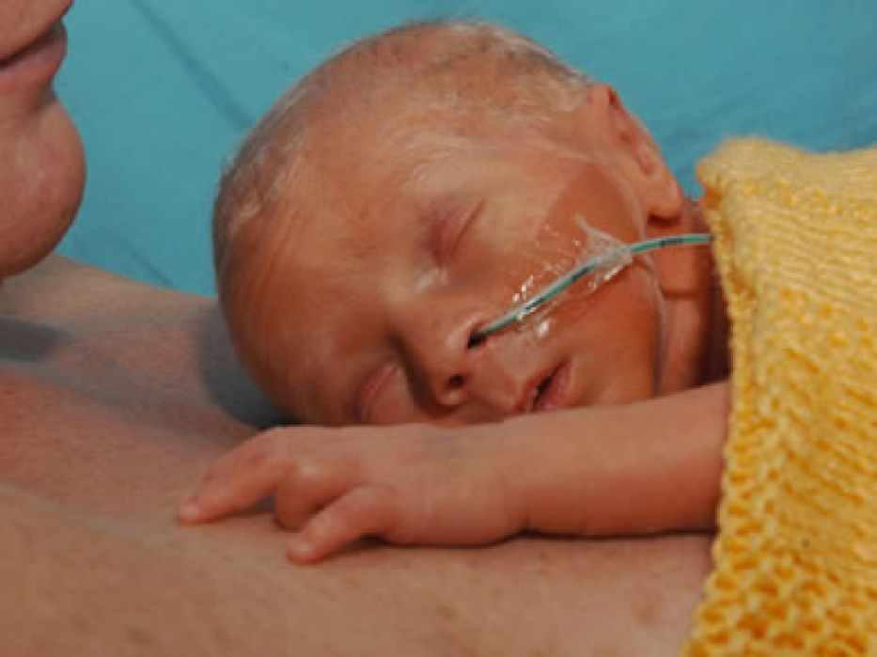

Slide 46
The end

Slide 52
Breastfeeding challenges & the preterm mother-infant Dyad
MALAKIAN.MD

Slide 53
1- LOW PREVALENCE OF BREASTFEEDING IS A MAJOR PROBLEM ACROSS THE GLOBE. 2- WORLDWIDE, ONLY 34 PERCENT OF INFANTS LESS THAN 6 MONTH ARE EXCLUSIVE BREASTFED. 3- ALTERNATIVE METHODS OF ENTERAL FEEDING ( GASTRIC TUBE ,CUP ,BOTTLE,...)ARE IN USE TO FEED INFANTS WHO ARE UNABLE BREASTFED.

Slide 54
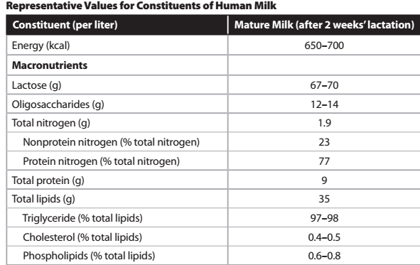

Slide 55
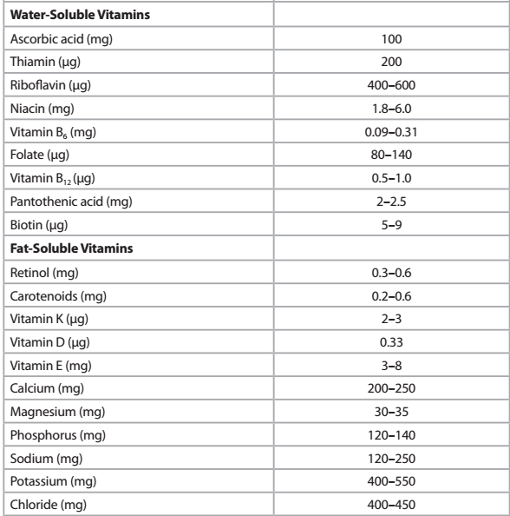

Slide 56
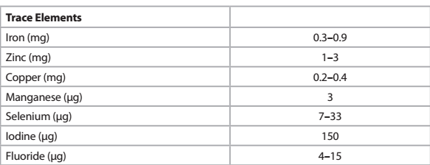

Slide 57
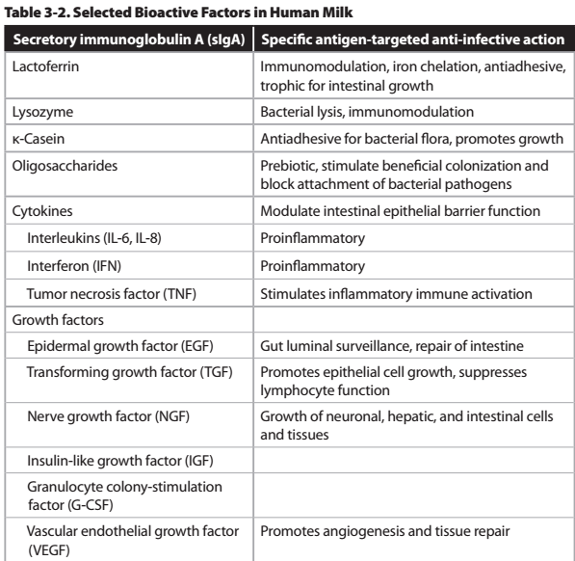

Slide 58
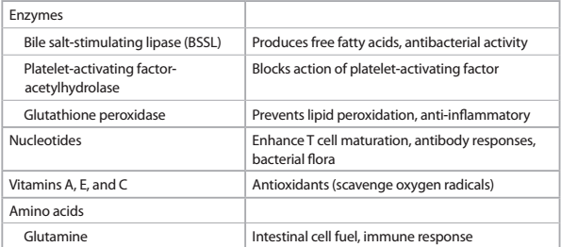

Slide 59
BREAST FEEDING IS THE BEST WAY OF FEEDING NEWBORN INFANTS

Slide 60
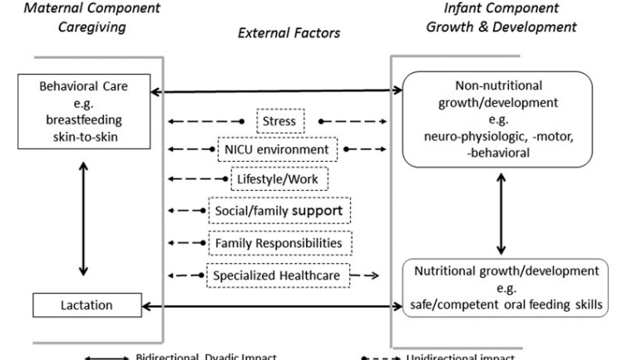

Slide 61
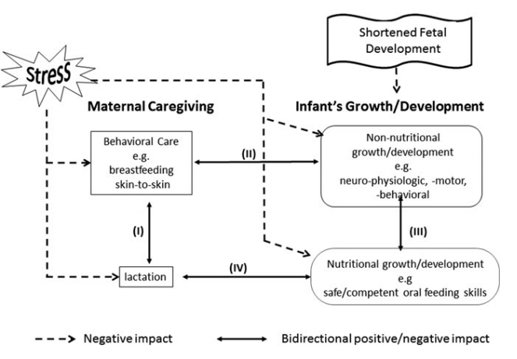

Slide 62
FEEDING IN A PRETERM INFANT CAN BE A CHALLENGE

Slide 63
FEEDING OF PRETERM INFANTS
Proper nutrition in infancy is essential for:
Normal growth
Resistance to infection
Neurologic development
Cognitive development
Long term health

Slide 64
FEEDING PROBLEMS IN PRETERM INFANT
-Immaturity of bowel function
-Inability to suck & swallow
-High risk for NEC
-Illnesses (RDS , PDA ,….)
-Medical Interventions (UAC, UVC, ET, Indomethacin therapy ,…)

Slide 65
PHYSIOLOGY & PATHOPHYSIOLOGY
By 10 weeks :Gut formation & rotation
By 16 weeks : the fetus can swallow AF
BY 24 weeks : GI motor activity is present / Sucking
BY 29-30 weeks : organized peristalsis estabilished
By 32-34 weeks : Coordination of sucking & swallowing&Breathing.

Slide 66
FEEDING IN PRETERMS (GOALS)
Adequate weight gain
Safe for baby
Consistency between caregivers
Family involvement

Slide 67
FEEDING PROTOCOL
Method of feeding
Content of feeding
Guidelines for feeding

Slide 68
Feeding in preterm infants
BBW<1200 gr (GA<30 Wks) :
Gavage feeding + finger feeding (mainly nonnutritive)
BW 1200 - 1500 gr (GA 30-32 wks):
Gavage feeding (mainly) + cup feeding or spoon feeding
BW> 1500 gr (GA > 32 WKs):
Breastfeeding or cup feeding + gavage feeding
BW>1800 gr (GA>34 WKs):
Breastfeeding +_ cup feeding

Slide 69
GAVAGE FEEDING
Weak sucking
Un-coordinated sucking & swallowing
Respiratory distress ( tachypnea )

Slide 70
HELPFUL HINTS (GAVAGE)
Give your baby a pacifier during the feeding.
Switch nostrils with each tube exchange(every2-3 days).
Calming your baby during gavage.
Touch & talk to your baby during the feeding.

Slide 71
Feeding tubes (side hole) F5 & F8

Slide 72
What equipment is needed for fixation a NG tube(gavage )
Feeding tube - syringe 3cc , 5cc -tape –stethoscope - blanket

Slide 73
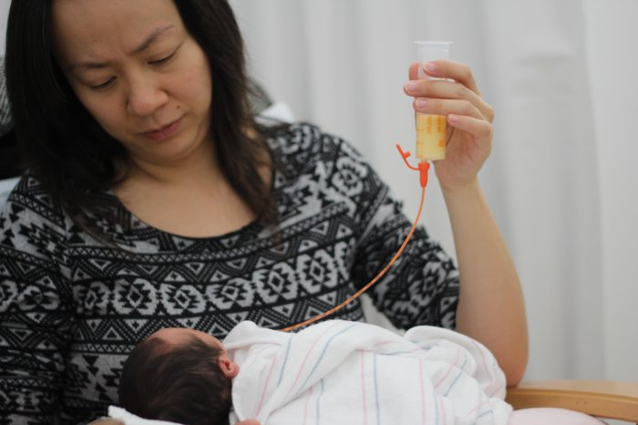
How do I put in a feeding tube ?
1-hand washing 2-measure & mark the tube 3-swaddle your baby
4-moisten the end of the tube 5- insertion 6- check

Slide 74
How do I give a gavage feeding ?
1-Comfortabale position 2-Remove the plunger 3-add milk
4-Raising the syringe 18 cm

Slide 75
Gavage feeding - bolus feeding

Slide 76
Gavage feeding - Continuous feeding

Slide 77
WHAT ARE THE POSSIBLE PROBLEMS ?
IMPROPERLY PLACED TUBE (MOST COMMON):
Coughing
Fighting the tube
Cyanosis
Apnea

Slide 78
FINGER FEEDING
IS A BREAST FEEDING ALTERNATIVE USED FOR WHEN BABY REFUSES THE BREAST
REFUSES TO LATCH ON
IS USED TO TRAIN BABY TO SUCK

Slide 79
Finger feeding

Slide 80
HOW TO FINGER FEED
Wash your hands
Babies head needs to be supported and he/she should be facing you
You will need a lactation aid which is a feeding tube that is attached to a feeding bottle.
Using your finger you can start to gently tickle baby's lips, so that baby can start sucking on your finger
Your finger should be placed with the soft part on baby's palate.
If baby dose not suck, you might need to lift the feeding bottle to allow the milk run down the tube.

Slide 81
Syringe feeding – finger feeding

Slide 82
Syringe feeding

Slide 83
Finger feeding

Slide 84
Finger feeding

Slide 85
Finger feeding

Slide 86
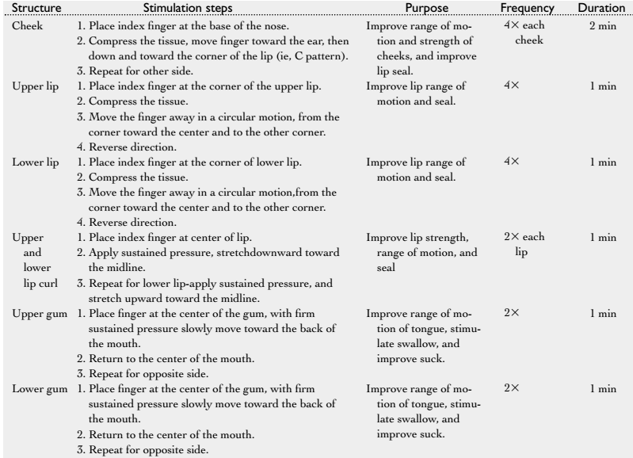

Slide 87
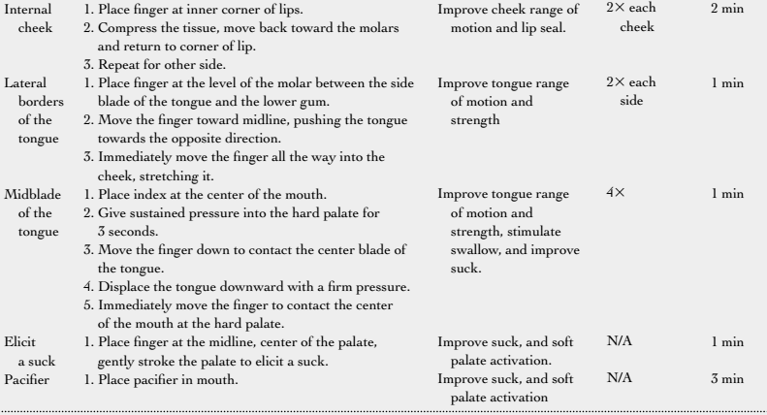

Slide 88
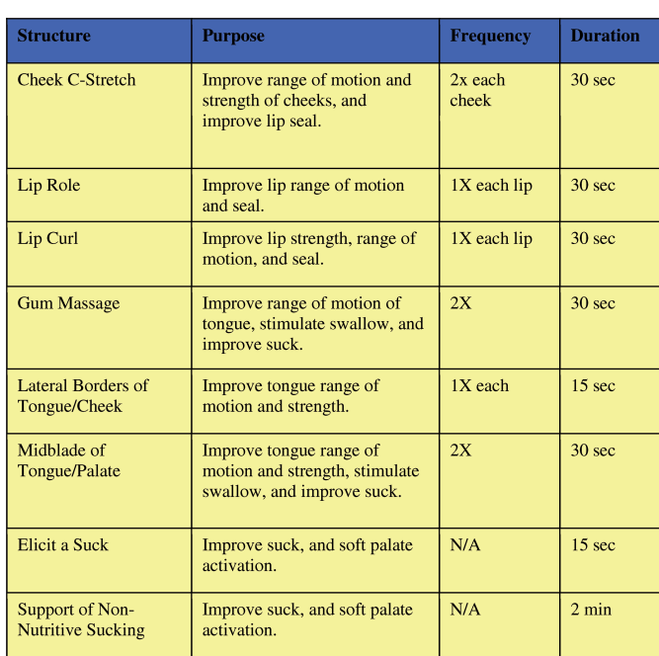

Slide 91
CUP FEEDING
The baby-friendly hospital Initiative guidelines recommendation

Slide 92
Cup feeding
USED MOSTLY IN PRETERM INFANTS
INFANTS WITH CLEFT LIP or PALATE
ONLY BE USED ON BABIES THAT ARE PAST 32 WKS. GA

Slide 93
How to cup feed Baby
Use a small cup that holds just 1-2 ounces of human milk or formula(medicine cup ,special cup).
Try to cup feed baby ,when he/she is alert.
Swaddle baby(cup is not knocked over).
Baby should be in an upright position.
Tuck a small towel under baby's chin to absorb drips.
Fill the cup half full with breast milk or formula.
Fill several cups(don’t interrupt the rhythm)
Tip the cup so that the milk only touches baby's lip.
DON’T POUR THE MILK INTO BABYS MOUTH.

Slide 94
HOW TO CUP FEED BABY (CONT.)
Baby should lap or sip at the milk.
Stop to burp baby every few minutes.

Slide 95
Cup feeding
Upright position & head support

Slide 96
CUP FEEDING (ADVANTAGES)
LESS Regurgitation
Less colic symptoms
Better weight gain
Easily learnt skill for an infant
Provides more appropriate movement of mouth and jaw compared to bottle feeding
Less time- consuming
No nipple confusion
Decreases the need for gavage feeding after 32wks
Provide more social stimulation compared to bottle feeding
Less stressful for the baby
Can be done by the whole family
Baby feeding cups are inexpensive and easy to use

Slide 97
CUP FEEDING (DISADVANTAGES)
Newborn might learn to prefer the cup over breastfeeding.
It does not cater for the baby,s need to suck.
Danger of aspirating milk.

Slide 98
CUP feeding

Slide 99
Cup feeding

Slide 100
Historical Cup

Slide 101
Supplemental Nutrition System

Slide 102
SUPPLEMENTING WHILE BREASTFEEDING
Lactation aids or
Nursing supplementer or
Supplemental nutrition system (SNS )

Slide 103
SNS
Are used to supplement baby while he/she is at the breast.
Is a device that allows a mother to supplement her baby with expressed breast milk,formula,… with using a bottle & tube.

Slide 104
TO USE A SUPPLEMENTER
The baby must be willing and able to latch onto the breast .

Slide 105
Supplemental nutrition sys. (SNS)

Slide 106
SNS

Slide 107
SNS INDICATIONS
Mothers who are nursing adopted babies .
Mothers who are relactating.(after a premature weaning )
Preterm's
Sucking problems

Slide 108
HOW TO USE AN SNS
proper latching on
Tube can be taped to moms breasts
Mom might need to hold the tube in place
If baby take longer than 20 min. for 30 ml latch on is not proper

Slide 109
SNS ADVANTAGES
Babies are kept on the breast
Mothers learn to breastfeed
Baby is less likely to reject the breast
Moms breasts are stimulated to increase milk supply.

Slide 110
OTHER ALTERNATIVE FEEDING METHODS
Haberman bottle
Spoon feeding
Syringe feeding
Eyedropper

Slide 111
تشکر از توجه شما

Slide 112
HABERMAN FEEDER
The feeder's design enables the feeder to be activated by tongue and gum pressure, imitating the mechanics involved in breastfeeding, rather than by sucking.
A one-way valve separates the nipple from the bottle. Milk cannot flow back into the bottle and is replenished continuously as the baby feeds.
A slit valve opening near the tip of the nipple shuts between jaw compressions, preventing the baby from being overwhelmed with milk.
Stopping or reducing the flow of milk is controlled by rotation of the nipple in the baby's mouth.
Usually the nipple is marked with lines that indicate zero flow, moderate flow, and maximum flow.

Slide 113
1-Teat, inserted into the baby's mouth. 2-Teat, this part is used to gently squeeze the milk into the baby's mouth and to keep the teat filled with milk. 3-Flexible part of the valve. 4-Ring to keep the teat and valve. 5-Standard sized baby bottle.

